Slide 1

HanDIYcraft
FINAL PROGRESS REPORT
By
Nahathai Kaewtatib 542115018
Pimchanok Sripraphan 542115043

Slide 2
Agenda
Introduction
Final Progress report work items
Our system
Software demo
Mistakes and problems

Slide 3


Introduction

Slide 4

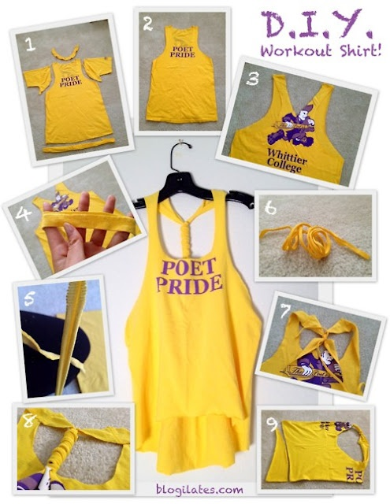

Introduction
DO
It
Yourself

Slide 5


Introduction
Where?
material they want

Slide 6

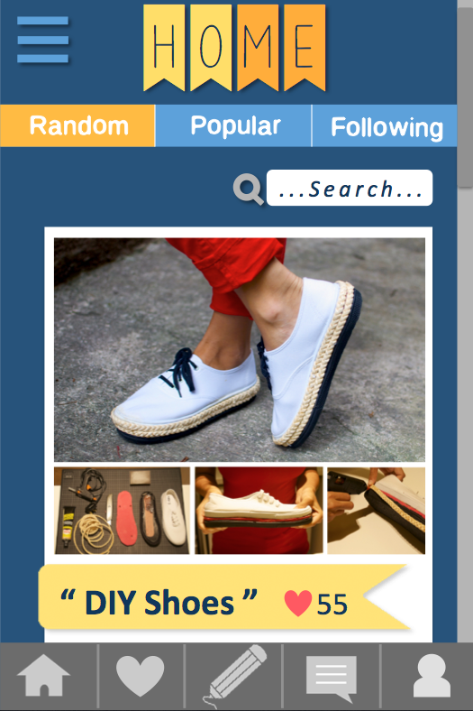
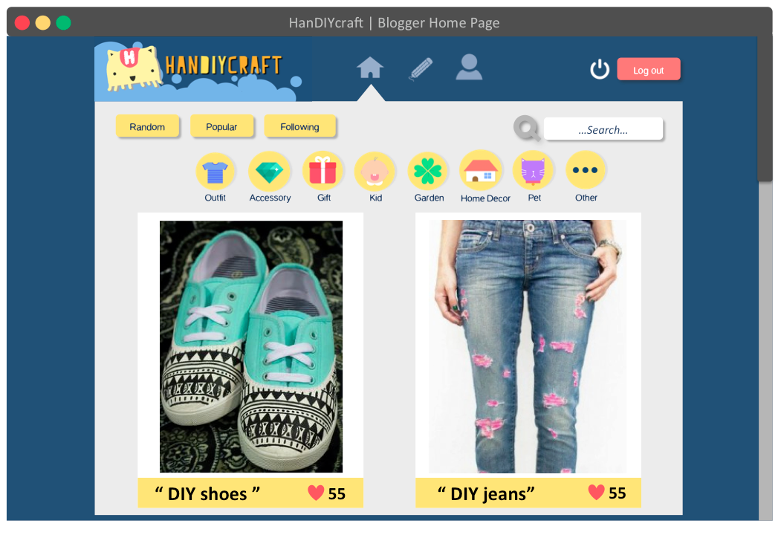
Introduction
HanDIYcraft

Slide 7






Users
send messages
Explore shops
Explore tutorials
manage tutorials
Share to facebook
comment
Search blogger
send messages
manage
shops
visitor
blogger
shopkeeper

Slide 8






Features
Authorization
tutorial
shop
map
communication
notification

Slide 9


Aims
Explore tutorials
Share and communicate

Slide 10


Aims
Find shops location
and
guide the direction
Advertise shops

Slide 11



Objectives
Open source

Slide 12



Objectives
Explore
manage

Slide 13



Limits
Operates on
requires
No security
Android os
Internet
connection
Inappropriate
information

Slide 14
Final Progress Report
Work items

Slide 15
Work items
Project
plan
SRS software requirement specification]
SDD [software design document]
Traceability record
Test plan
Test record
Project status report
Executive summary
Change request

Slide 16
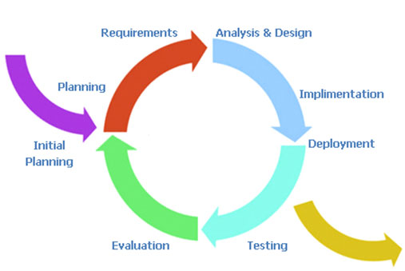
Project Plan

Slide 17

Repository

Slide 18

SRS Document
Use Case
User Requirement Specification (URS) and Description
Activity Diagram
System Requirement Specification (SRS)
2
65 ( W: 19 , M: 46 )
61 (W: 18 , M: 43 )
134 ( W: 42 , M: 92 )

Slide 19


Requirement Analysis
feature
Use case
urs
srs
Activity
diagram
Urs
description

Slide 20
Software Design
System Architecture
Class Diagram and Description
Sequence Diagram
Database Design
User Interface Design
Traceability Record
41
60 ( W: 15 , M: 45 )
16 tables

Slide 21


Software Construction
SRS [software requirement specification]
SDD [software design document]
HanDIYcraft
HanDIYcraft

Slide 22
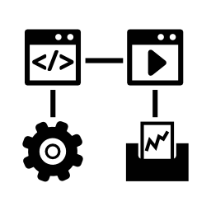

Software Testing
Unit Testing
92 ( W: 20 , M: 72 )
Input
Output

Slide 23

Software Testing
System Testing
64 ( W: 19 , M: 45 )
Input
Output

Slide 24
Our System

Slide 25

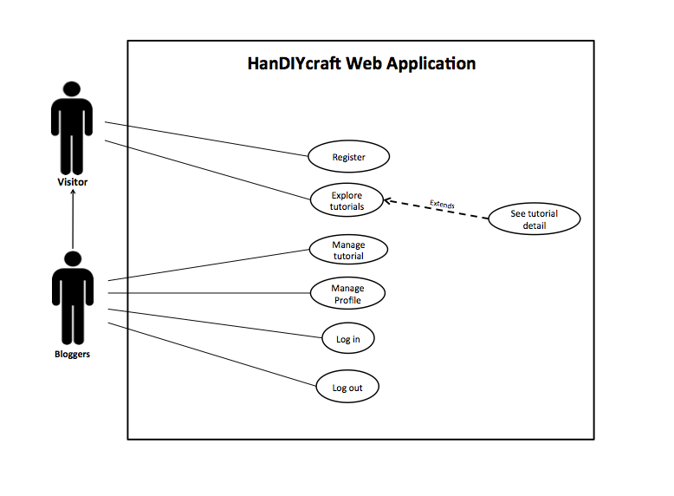
Use case

Slide 26

Use case

Slide 27




Architecture
Explore
Visitors
Manage
HanDIYcraft
Google Maps API
Bloggers
Shopkeepers
Facebook
request
response
JSON
request
HanDIYcraft
My SQL
response
JSON
Server

Slide 28
Class
diagram

Slide 29
Database design

Slide 30

User interface design

Slide 31

User interface design

Slide 32


URS & URS Description
M-URS-09: The user randomly sees tutorials that exist in database.
Input
output

Slide 33
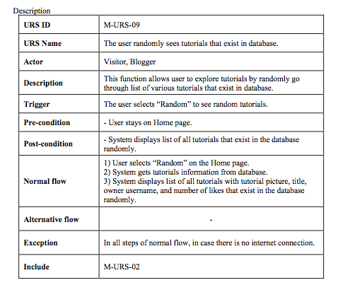
URS description

Slide 34
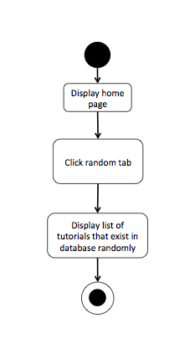
Activity diagram

Slide 35
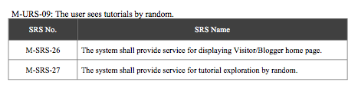
SRS

Slide 36
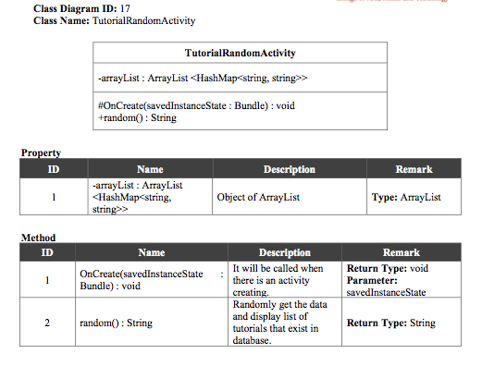
Class Diagram Description

Slide 37
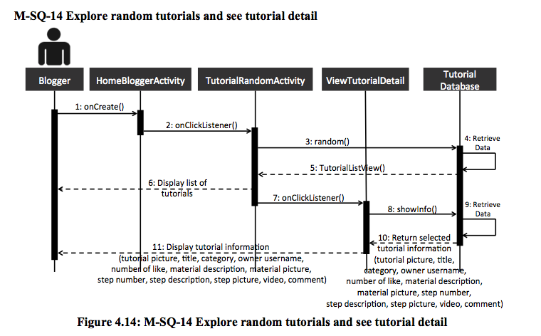
Sequence diagram

Slide 38
Database

Slide 39
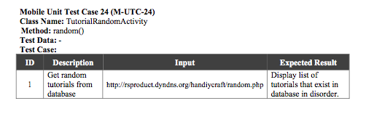
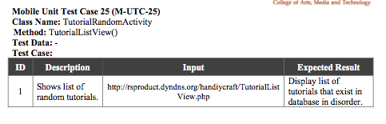
Unit test case

Slide 40
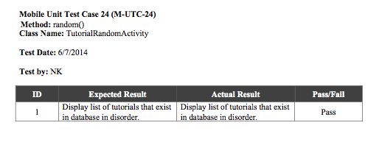
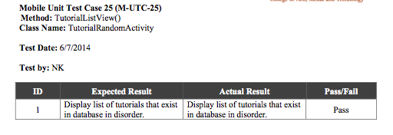
unit Test record

Slide 41
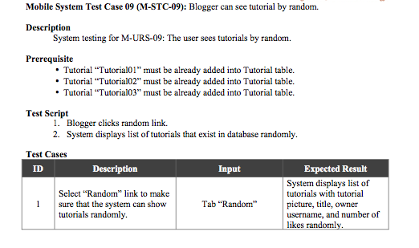
System test case

Slide 42
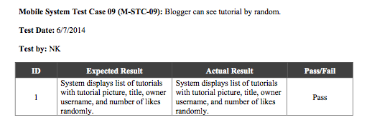
System Test record

Slide 43
Software
Demo

Slide 44
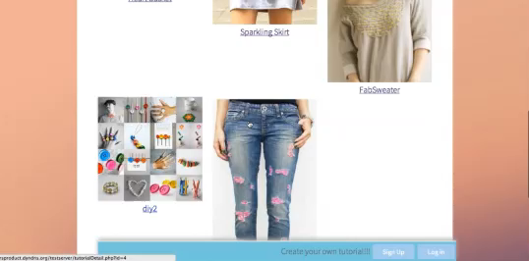

Software Demo

Slide 45
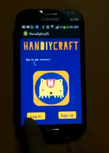
Software Demo

Slide 46
Mistakes and
Problems

Slide 47
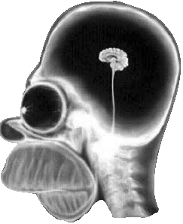

Mistakes&Problems
Carelessness and Less technical knowledge

Slide 48
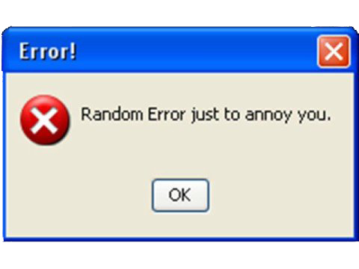
Mistakes&Problems
Silly mistake

Slide 49

Mistakes&Problems
Poor internet connection

Slide 50

Mistakes&Problems
Time Management

Slide 51

Mistakes&Problems
User interface

Slide 52
Q&A

